Slide 1
shortest paths
David Kauchak CS 140 – Spring 2024

Slide 2
Admin
Assignment 8
No mentor hours Friday

Slide 3
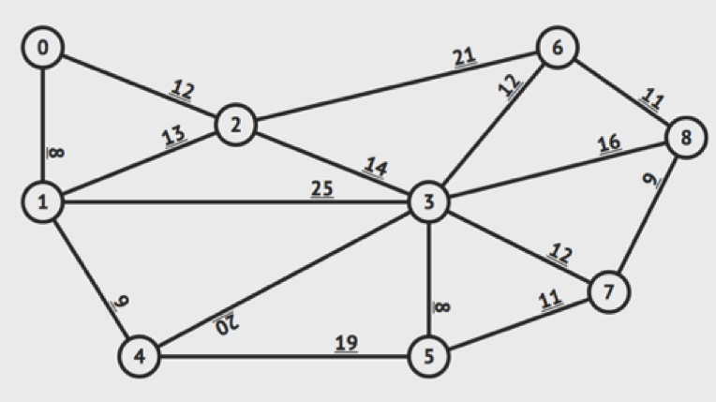
Practice

Slide 4
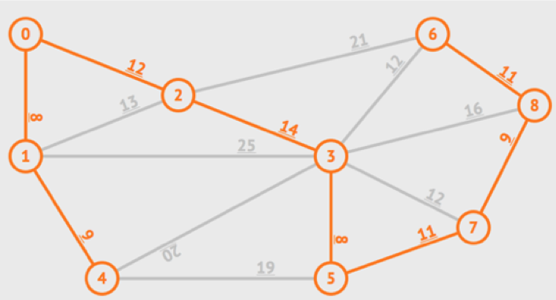
Solution
Sum = 8 + 8 + 9 + 9 + 11 + 11 + 12 + 14 = 82

Slide 5
Minimum spanning trees
What is the lowest weight set of edges that connects all vertices of an undirected graph with positive weights
Input: An undirected, positive weight graph, G=(V,E)
Output: A tree T=(V,E’) where E’ ⊆ E that minimizes

Slide 6
MST example
1
A
C
E
3
4
4
4
2
5
B
D
F
4
6
1
A
C
E
4
4
2
5
B
D
F

Slide 7
Minimum cut property
Given a partition S, let edge e be the minimum cost edge that crosses the partition. Every minimum spanning tree contains edge e.
1
A
C
E
3
4
4
4
2
5
B
D
F
4
6

Slide 8
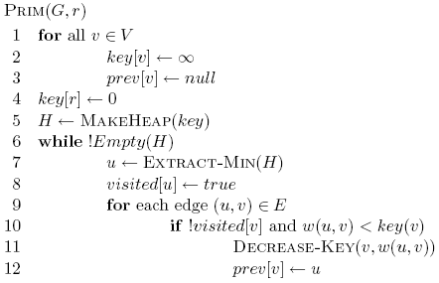
Prim’s algorithm
Start at some root node and build out the MST by adding the lowest weighted edge out of the MST constructed so far

Slide 9
Correctness of Prim’s?
Can we use the min-cut property?
Given a partion S, let edge e be the minimum cost edge that crosses the partition. Every minimum spanning tree contains edge e.
Let S be the set of vertices visited so far
The only time we add a new edge is if it’s the lowest weight edge from S to V-S

Slide 10
Prim’s
1
A
C
E
3
5
4
4
4
3
MST
1
5
4
B
D
F
2
6
A
C
E
B
D
F
4
3
0

Slide 11
Running time of Prim’s

Slide 12
Running time of Prim’s
Θ(|V|)
1 call to MakeHeap
|V| calls to Extract-Min
|E| calls to Decrease-Key

Slide 13
Running time of Prim’s
1 MakeHeap
|V| ExtractMin
|E| DecreaseKey
Total
Array
θ(|V|)
O(|V|²)
O(|E|)
O(|V|²)
Bin heap
θ(|V|)
O(|V| log |V|)
O(|E| log |V|)
O((|V|+|E|) log |V|)
O(|E| log |V|)
Fib heap
θ(|V|)
O(|V| log |V|)
O(|E|)
O(|V| log |V| + |E|)
Kruskal’s: O(|E| log |E| )

Slide 14
Running time of Prim’s
When should we use Kruskal’s or Prim’s?
1 MakeHeap
|V| ExtractMin
|E| DecreaseKey
Total
Array
θ(|V|)
O(|V|²)
O(|E|)
O(|V|²)
Bin heap
θ(|V|)
O(|V| log |V|)
O(|E| log |V|)
O((|V|+|E|) log |V|)
O(|E| log |V|)
Fib heap
θ(|V|)
O(|V| log |V|)
O(|E|)
O(|V| log |V| + |E|)
Kruskal’s: O(|E| log |E| )

Slide 15
Shortest paths
What is the shortest path from a to d?
B
D
A
C
E

Slide 16
Shortest paths
How can we find this?
B
D
A
C
E

Slide 17
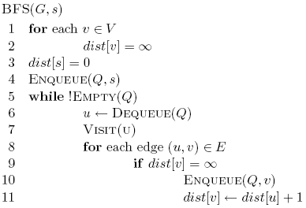
Shortest paths
BFS
B
D
A
C
E

Slide 18
Shortest paths
What is the shortest path from a to d?
2
B
D
3
3
A
1
2
1
C
E
4

Slide 19
Shortest paths
What is the shortest path from a to d?
2
B
D
3
3
A
1
2
1
C
E
4

Slide 20
Shortest path algorithms?

Slide 21
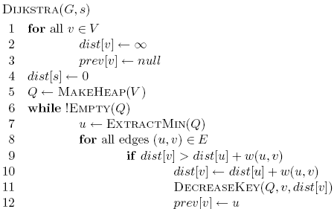
Dijkstra’s algorithm
What is dist?
What is prev?
How does it work?
What is the run-time?
How do we get the shortest path?

Slide 22
Dijkstra’s algorithm

Slide 23
Dijkstra’s algorithm
prev keeps track of the shortest path

Slide 24
Dijkstra’s algorithm

Slide 25
Dijkstra’s algorithm

Slide 26
Dijkstra’s algorithm

Slide 27
3
B
D
3
1
A
1
2
1
C
E
4

Slide 28
∞
∞
3
B
D
3
∞
1
A
1
2
∞
1
C
E
∞
4

Slide 29
Heap
A 0 B ∞ C ∞ D ∞ E ∞
∞
∞
3
B
D
3
0
1
A
1
2
∞
1
C
E
∞
4

Slide 30
Heap
B ∞ C ∞ D ∞ E ∞
∞
∞
3
B
D
3
0
1
A
1
2
∞
1
C
E
∞
4

Slide 31
Heap
B ∞ C ∞ D ∞ E ∞
∞
∞
3
B
D
3
0
1
A
1
2
∞
1
C
E
∞
4

Slide 32
Heap
C 1 B ∞ D ∞ E ∞
∞
∞
3
B
D
3
0
1
A
1
2
1
1
C
E
∞
4

Slide 33
Heap
C 1 B ∞ D ∞ E ∞
∞
∞
3
B
D
3
0
1
A
1
2
1
1
C
E
∞
4

Slide 34
Heap
C 1 B 3 D ∞ E ∞
3
∞
3
B
D
3
0
1
A
1
2
1
1
C
E
∞
4

Slide 35
Heap
C 1 B 3 D ∞ E ∞
3
∞
3
B
D
3
0
1
A
1
2
1
1
C
E
∞
4

Slide 36
Heap
B 3 D ∞ E ∞
3
∞
3
B
D
3
0
1
A
1
2
1
1
C
E
∞
4

Slide 37
Heap
B 3 D ∞ E ∞
3
∞
3
B
D
3
0
1
A
1
2
1
1
C
E
∞
4

Slide 38
Heap
B 3 D ∞ E ∞
3
∞
3
B
D
3
0
1
A
1
2
1
1
C
E
∞
4

Slide 39
Heap
B 2 D ∞ E ∞
2
∞
3
B
D
3
0
1
A
1
2
1
1
C
E
∞
4

Slide 40
Heap
B 2 D ∞ E ∞
2
∞
3
B
D
3
0
1
A
1
2
1
1
C
E
∞
4

Slide 41
Heap
B 2 E 5 D ∞
2
∞
3
B
D
3
0
1
A
1
2
1
1
C
E
5
4

Slide 42
Heap
E 3 D 5
2
5
3
B
D
3
0
1
A
1
2
1
1
C
E
3
4

Slide 43
Heap
D 5
2
5
3
B
D
3
0
1
A
1
2
1
1
C
E
3
4

Slide 44
Heap
2
5
3
B
D
3
0
1
A
1
2
1
1
C
E
3
4

Slide 45
Heap
2
5
3
Prev
B
D
0
1
A
1
1
1
C
E
3

Slide 46
Heap
2
5
3
Prev
B
D
0
1
How do we get the actual paths?
A
1
1
1
C
E
3

Slide 47
Is Dijkstra’s algorithm correct?
Invariant: For every vertex removed from the heap, dist[v] is the actual shortest distance from s to v
proof?

Slide 48
Is Dijkstra’s algorithm correct?
Invariant: For every vertex removed from the heap, dist[v] is the actual shortest distance from s to v
The only time a vertex gets visited is when the distance from s to that vertex is smaller than the distance to any remaining vertex
Therefore, there cannot be any other path that hasn’t been visited already that would result in a shorter path

Slide 49
Running time?

Slide 50
Running time?
Θ(|V|)
1 call to MakeHeap
|V| calls to Extract-Min
|E| calls to Decrease-Key

Slide 51
Running time?
Depends on the heap implementation
1 MakeHeap
|V| ExtractMin
|E| DecreaseKey
Total
Array
O(|V|)
O(|V|²)
O(|E|)
O(|V|²)
Bin heap
O(|V|)
O(|V| log |V|)
O(|E| log |V|)
O((|V|+|E|) log |V|)
O(|E| log |V|)

Slide 52
Running time?
Depends on the heap implementation
1 MakeHeap
|V| ExtractMin
|E| DecreaseKey
Total
Array
O(|V|)
O(|V|²)
O(|E|)
O(|V|²)
Bin heap
O(|V|)
O(|V| log |V|)
O(|E| log |V|)
O((|V|+|E|) log |V|)
O(|E| log |V|)
Is this an improvement?
If |E| < |V|² / log |V|

Slide 53
Running time?
Depends on the heap implementation
1 MakeHeap
|V| ExtractMin
|E| DecreaseKey
Total
Array
O(|V|)
O(|V|²)
O(|E|)
O(|V|²)
Bin heap
O(|V|)
O(|V| log |V|)
O(|E| log |V|)
O((|V|+|E|) log |V|)
O(|E| log |V|)
Fib heap
O(|V|)
O(|V| log |V|)
O(|E|)
O(|V| log |V| + |E|)

Slide 54
Dijkstra’s vs Prim’s

Slide 55
What about Dijkstra’s on…?
1
1
B
D
A
5
10
-10
C
E

Slide 56
What about Dijkstra’s on…?
Dijkstra’s algorithm only works for positive edge weights
1
1
B
D
A
5
10
C
E

Slide 57
Is Dijkstra’s algorithm correct?
Invariant: For every vertex removed from the heap, dist[v] is the actual shortest distance from s to v
The only time a vertex gets visited is when the distance from s to that vertex is smaller than the distance to any remaining vertex
Therefore, there cannot be any other path that hasn’t been visited already that would result in a shorter path
We relied on having positive edge weights for correctness!

Slide 58
Bounding the distance
Another invariant: For each vertex v, dist[v] is an upper bound on the actual shortest distance
Is this a valid invariant?

Slide 59
Bounding the distance
Another invariant: For each vertex v, dist[v] is an upper bound on the actual shortest distance
start off at ∞
only update the value if we find a shorter distance
An update procedure: for an edge (u,v)

Slide 60
Can we ever go wrong applying this update rule?
We can apply this rule as many times as we want and will never underestimate dist[v]
When will dist[v] be right?
If u is along the shortest path to v and dist[u] is correct

Slide 61
dist[v] will be right if u is along the shortest path to v and dist[u] is correct
Consider the shortest path from s to v
s
p₁
p₂
p₃
p_{k}
v

Slide 62
dist[v] will be right if u is along the shortest path to v and dist[u] is correct
What happens if we update all of the vertices with the above update?
s
p₁
p₂
p₃
p_{k}
v

Slide 63
dist[v] will be right if u is along the shortest path to v and dist[u] is correct
What happens if we update all of the vertices with the above update?
s
p₁
p₂
p₃
p_{k}
v
correct

Slide 64
dist[v] will be right if u is along the shortest path to v and dist[u] is correct
What happens if we update all of the vertices with the above update?
s
p₁
p₂
p₃
p_{k}
v
correct
correct

Slide 65
dist[v] will be right if u is along the shortest path to v and dist[u] is correct
Does the order that we update the vertices matter?
s
p₁
p₂
p₃
p_{k}
v
correct
correct
Notes:
yes! If we did it in the order of the correct path, we’d be done.

Slide 66
dist[v] will be right if u is along the shortest path to v and dist[u] is correct
How many times do we have to do this for vertex p_{i} to have the correct shortest path from s?
i times
s
p₁
p₂
p₃
p_{k}
v

Slide 67
dist[v] will be right if u is along the shortest path to v and dist[u] is correct
How many times do we have to do this for vertex p_{i} to have the correct shortest path from s?
i times
s
p₁
p₂
p₃
p_{k}
v
correct
correct

Slide 68
dist[v] will be right if u is along the shortest path to v and dist[u] is correct
How many times do we have to do this for vertex p_{i} to have the correct shortest path from s?
i times
s
p₁
p₂
p₃
p_{k}
v
correct
correct
correct

Slide 69
dist[v] will be right if u is along the shortest path to v and dist[u] is correct
How many times do we have to do this for vertex p_{i} to have the correct shortest path from s?
i times
s
p₁
p₂
p₃
p_{k}
v
correct
correct
correct
correct

Slide 70
dist[v] will be right if u is along the shortest path to v and dist[u] is correct
How many times do we have to do this for vertex p_{i} to have the correct shortest path from s?
i times
s
p₁
p₂
p₃
p_{k}
v
…
correct
correct
correct
correct

Slide 71
dist[v] will be right if u is along the shortest path to v and dist[u] is correct
What is the longest (vertex-wise) the path from s to any node v can be?
|V| - 1 edges/vertices
s
p₁
p₂
p₃
p_{k}
v
…
correct
correct
correct
correct

Slide 72
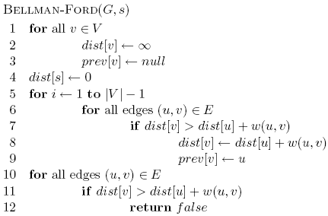
Bellman-Ford algorithm

Slide 73
Bellman-Ford algorithm
Initialize all the distances
do it |V| -1 times
iterate over all edges/vertices and apply update rule

Slide 74
Bellman-Ford algorithm
check for negative cycles

Slide 75
Negative cycles
What is the shortest path from a to e?
1
1
B
D
A
5
10
-10
C
E
3

Slide 76
Bellman-Ford algorithm

Slide 77
Bellman-Ford algorithm
10
How many edges is the shortest path from s to:
S
A
8
1
G
-4
B
A:
2
1
1
-2
B:
F
C
-1
3
E
D
D:
-1

Slide 78
Bellman-Ford algorithm
10
How many edges is the shortest path from s to:
S
A
8
1
G
-4
B
A:
3
2
1
1
-2
C
F
-1
3
E
D
-1

Slide 79
Bellman-Ford algorithm
10
How many edges is the shortest path from s to:
S
A
8
1
G
-4
B
A:
3
2
1
1
-2
B:
F
C
-1
3
E
D
-1

Slide 80
Bellman-Ford algorithm
10
How many edges is the shortest path from s to:
S
A
8
1
G
-4
B
A:
3
2
1
1
-2
B:
5
F
C
-1
3
E
D
-1

Slide 81
Bellman-Ford algorithm
10
How many edges is the shortest path from s to:
S
A
8
1
G
-4
B
A:
3
2
1
1
-2
B:
5
F
C
-1
3
E
D
D:
-1

Slide 82
Bellman-Ford algorithm
10
How many edges is the shortest path from s to:
S
A
8
1
G
-4
B
A:
3
2
1
1
-2
B:
5
F
C
-1
3
E
D
D:
7
-1

Slide 83
Bellman-Ford algorithm
0
∞
10
S
A
Iteration: 0
8
1
∞
∞
G
-4
B
2
1
1
-2
C
∞
F
∞
-1
3
E
D
-1
∞
∞

Slide 84
Bellman-Ford algorithm
0
10
10
S
A
Iteration: 1
8
1
∞
8
G
-4
B
2
1
1
-2
C
∞
F
∞
-1
3
E
D
-1
∞
∞

Slide 85
Bellman-Ford algorithm
0
10
10
S
A
Iteration: 2
8
1
∞
8
G
-4
B
2
1
1
-2
C
∞
F
9
-1
3
E
D
-1
12
∞

Slide 86
Bellman-Ford algorithm
0
5
10
S
A
Iteration: 3
8
1
10
8
G
-4
B
A has the correct distance and path
2
1
1
-2
C
∞
F
9
-1
3
E
D
-1
8
∞

Slide 87
Bellman-Ford algorithm
0
5
10
S
A
Iteration: 4
8
1
6
8
G
-4
B
2
1
1
-2
C
11
F
9
-1
3
E
D
-1
7
∞

Slide 88
Bellman-Ford algorithm
0
5
10
S
A
Iteration: 5
8
1
5
8
G
-4
B
B has the correct distance and path
2
1
1
-2
C
7
F
9
-1
3
E
D
-1
7
14

Slide 89
Bellman-Ford algorithm
0
5
10
S
A
Iteration: 6
8
1
5
8
G
-4
B
2
1
1
-2
C
6
F
9
-1
3
E
D
-1
7
10

Slide 90
Bellman-Ford algorithm
0
5
10
S
A
Iteration: 7
8
1
5
8
G
-4
B
D (and all other nodes) have the correct distance and path
2
1
1
-2
C
6
F
9
-1
3
E
D
-1
7
9

Slide 91
Correctness of Bellman-Ford
Loop invariant: After iteration i, all vertices with shortest paths from s of length i edges or less have correct distances

Slide 92
Runtime of Bellman-Ford
O(|V| |E|)

Slide 93
Runtime of Bellman-Ford
Can you modify the algorithm to run faster (in some circumstances)?

Slide 94
Shortest Paths
2
B
D
-1
1
3
-3
A
2
4
C
E
5
What is the shortest path from A to E?

Slide 95
Shortest Paths
2
B
D
-1
1
3
-3
A
2
4
C
E
5
-2

Slide 96
Shortest Paths
2
B
D
-1
1
3
-3
A
2
4
C
E
5
What algorithm would we use to calculate this?

Slide 97
Shortest Paths
2
B
D
-1
1
3
-3
A
2
4
C
E
5
Bellman-Ford (since the graph has negative edges)
O(VE)

Slide 98
Shortest Paths
2
B
D
-1
1
3
-3
A
2
4
C
E
5
Bellman-Ford (since the graph has negative edges)
O(VE)
Called a single-source shortest path algorithm. Why?

Slide 99
Shortest Paths
2
B
D
-1
1
3
-3
A
2
4
C
E
5
Bellman-Ford (since the graph has negative edges)
O(VE)
Calculate all paths from a single vertex.

Slide 100
Shortest Paths
2
B
D
-1
1
3
-3
A
2
4
C
E
5
What is the shortest path from A to C?
If we already calculated A to E using Bellman-Ford do we need to do any work?

Slide 101
Shortest Paths
2
B
D
-1
1
3
-3
A
2
4
C
E
5
No new calculations!
Bellman-Ford calculates all shortest paths starting at A.

Slide 102
Shortest Paths
2
B
D
-1
1
3
-3
A
2
4
C
E
5
What is the shortest path from D to C?
If we already calculated A to E using Bellman-Ford do we need to do any work?

Slide 103
Shortest Paths
2
B
D
-1
1
3
-3
A
2
4
C
E
5
Different source.
Have to run Bellman-Ford again!

Slide 104
All pairs shortest paths
All pairs shortest paths: calculate the shortest paths between all vertices
2
B
D
-1
1
3
-3
A
2
4
C
E
5

Slide 105
All pairs shortest paths
All pairs shortest paths: calculate the shortest paths between all vertices
Easy solution?

Slide 106
All pairs shortest paths
All pairs shortest paths: calculate the shortest paths between all vertices
Run Bellman-Ford from each vertex!
Running time (in terms of E and V)?

Slide 107
All pairs shortest paths
All pairs shortest paths: calculate the shortest paths between all vertices
Run Bellman-Ford from each vertex!
O(V²E)
Bellman-Ford: O(VE)
V calls, one for each vertex

Slide 108
DAGs?

Slide 109
Handout

Slide 110
Kruskals
Add smallest edge that connects two sets not already connected
Prims
Starting at 0, grow MST by adding lowest weight edge out of current MST

Slide 111
Bellman-Ford algorithm
0
∞
10
S
A
8
1
∞
∞
G
-4
B
2
1
1
-2
C
∞
F
∞
-1
3
E
D
-1
∞
∞

